Slide 1
Nikes sales dashboard
USING POWER BI
Presented By:
Chilakala Meghana Ranga Laxmi

Slide 2
DAX FUNCTIONS
DAX Total Sales = SUM('Data Sales Nike'[Units Sold])
DAX Average Margin = AVERAGE('Data Sales Nike'[Operating Margin])
DAX Unique Products = DISTINCTCOUNT('Data Sales Nike'[Product ID])
DAX Max Profit = MAX('Data Sales Nike'[Operating Profit])
DAX Sales Northeast = CALCULATE(SUM('Data Sales Nike'[Units Sold]), 'Data Sales Nike'[Region] = "Northeast")
DAX Instore Profit = CALCULATE(SUM('Data Sales Nike'[Operating Profit]), FILTER('Data Sales Nike', 'Data Sales Nike'[Sales Method] = "In-store"))
DAX Margin Per Unit = DIVIDE(SUM('Data Sales Nike'[Operating Profit]), SUM('Data Sales Nike'[Units Sold]))

Slide 3
DAX FUCNTIONS
DAX Product Rank = RANKX(ALL('Data Sales Nike'[Product Name]), SUM('Data Sales Nike'[Units Sold]), , DESC)
DAX Profit Percentage = DIVIDE(SUM('Data Sales Nike'[Operating Profit]), SUM('Data Sales Nike'[Units Sold]))
DAX Total Margin = CALCULATE(SUM('Data Sales Nike'[Operating Margin]), ALL('Data Sales Nike'[Region]))
DAX Transaction Count = COUNT('Data Sales Nike'[Invoice Date])

Slide 4
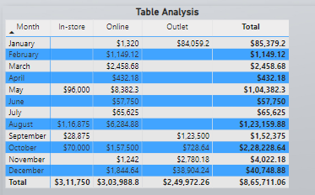
Monthly Sales Breakdown
This table shows monthly sales across In-store, Online, and Outlet channels, totaling $8.65 million annually. Outlet sales peaked in December with $3.88 million, driving the year's highest total of $4.07 million. In-store sales saw spikes in May ($96,000) and September ($1.12 million), while Online sales remained consistent at $3.04 million overall

Slide 5
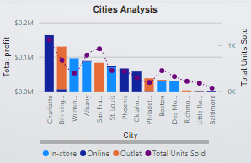
CITIES ANALYSIS CHART
This bar and line chart compares total profit and total units sold across various cities. It breaks down revenue sources by sales channels (In-store, Online, Outlet), highlighting Charlotte as a top-performing city and Baltimore with the lowest activity.

Slide 6
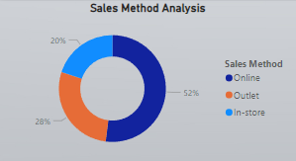
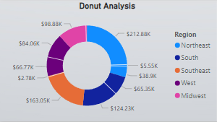
SALES METHOD ANALYSIS CHART
This pie chart illustrates the proportion of sales achieved through different channels. Online sales dominate at 52%, followed by Outlet at 28%, and In-store at 20%.

Slide 7
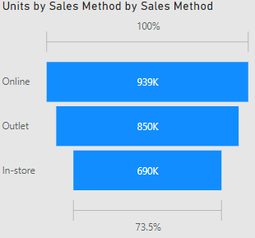
Units by Sales Method
The chart compares units sold across sales channels, with Online leading at 939K units, followed by Outlet with 850K, and In-store at 690K. Online sales dominate, reflecting customer preference for convenience, while Outlet and In-store show steady contributions. This analysis highlights the need to focus on channel-specific strategies to optimize performance and meet customer demand.

Slide 8
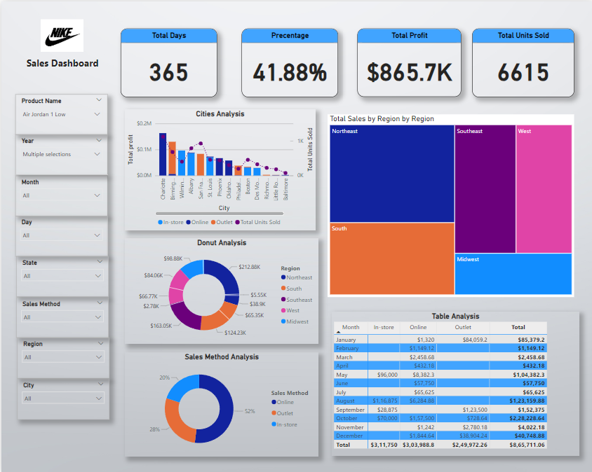
REPORT 1

Slide 9
REPORT 1
The Nike sales dashboard provides a detailed overview of performance metrics, including total profit, units sold, and sales percentage over 365 days. It features visual analyses such as city-wise sales comparisons, regional sales breakdowns, and sales method distributions. A treemap highlights region-wise contributions, while a table summarizes monthly sales across different channels. Filters allow for data segmentation by product, time, location, and sales method, offering comprehensive insights into sales trends and performance.

Slide 10
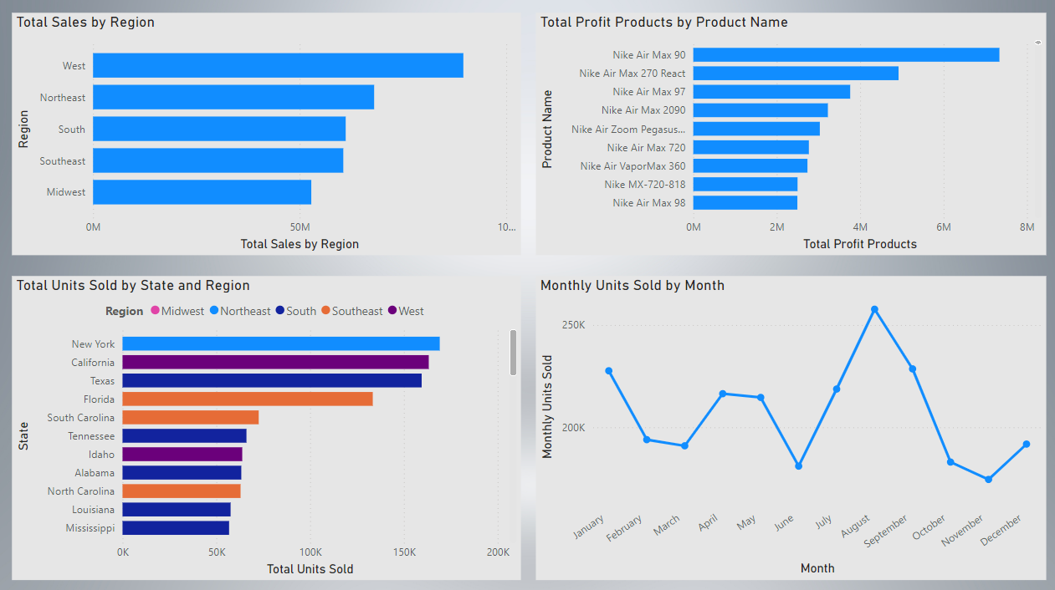
REPORT 2

Slide 11
REPORT 2
This report provides a comprehensive overview of sales and profitability trends. The West region leads in total sales, with New York, California, and Texas as key contributors to unit sales across states. Nike Air Max models, particularly the Air Max 90, dominate profitability, highlighting their strong market demand. Monthly sales patterns reveal a peak in August, followed by a dip in the fall and a slight rebound in December. These insights showcase regional strengths, high-performing products, and seasonal fluctuations, offering valuable direction for strategic planning and resource allocation.

Slide 12
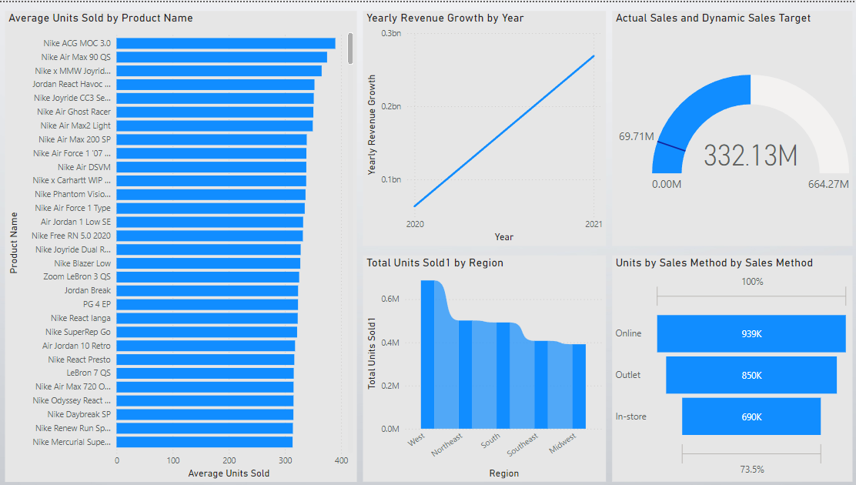
REPORT 3

Slide 13
RECORD 3
The dashboard provides an in-depth analysis of Nike's sales performance, focusing on average units sold by product, yearly revenue growth, and regional sales distribution. It highlights top-performing products like Nike ACG MOC 3.0 and Nike Air Max 90 QS. A clear upward trend in yearly revenue is visible, with significant growth from 2020 to 2021. The actual sales versus dynamic target chart indicates progress toward a sales goal of 664.27M, with 332.13M achieved. Regional sales analysis shows the West as the highest contributor to total units sold. Additionally, sales methods are compared, with online sales leading, followed by outlets and in-store transactions. The dashboard effectively combines visuals to present key sales insights and trends.

Slide 14
CONCLUSION
The analysis highlights Nike's sales performance, with key regions and products driving significant revenue. Average margins reflect efficient cost management, though some areas require improvement. Top-selling products and channel-specific insights reveal opportunities to optimize marketing and inventory strategies. Regional analysis suggests tailored approaches for growth. By focusing on high performers, improving underperforming areas, and refining sales channels, Nike can drive sustained growth and profitability.

